Slide 1
Current and Emerging Approaches to Impact Evaluation: The Need for Systems Perspectives
Juan D. Rogers
School of Public Policy
Georgia Institute of Technology

Slide 2
Presentation Outline
Framing and Measuring: Systems and Indicators
Examples of Systems Evaluation Challenges
Some Principles on Systems Approaches
Group Discussion Prompt

Slide 3
Framing and Measuring
Standard problems in evaluating impact of science:
Long term effects
Attribution of effects
Many reasons: unknown knowledge flow pathways; transformation upon use; science as effect rather than cause; unknown impact mechanisms; field and topic differences.
Low downstream involvement
Framing (assumptions):
Instrumental view of knowledge/science
Independence of activity/effects pathways
Aggregate effects of knowledge/science are additive

Slide 4
Framing and Measuring: Systems Thinking
Common assumptions are mostly false:
Role of stakeholders in defining the value of science
Output is obviously “disproportionate”
Attribution of effects is not separable
Knowledge as input changes the system structure
Unpredictable branches and multiple development directions
A few illustrations from past projects…

Slide 5
Value-in-use map for Synthesis and Optimization of Chemical Processes case
Legend
Ri: Research uses; Li: Licenses; Ci: Commercial development; Hi: Human capital; Cpi: Commercial plants;
Cni: Consulting; Rci: Research collaborations
R1 Energy flow optimization software H1 Graduates to software industries
R2 Energy integration expert systems H2 Graduates to chemical industries
R3 Batch process modeling H3 From software to chemical industries
L1 Aspen Technologies Cpi Commercial plant uses
L2 Competing companies Cni Consulting portfolio
C1 Aspen Tech software P BES program management portfolio
C2 Competing products Rc1 Research collaboration

Slide 6
Value-in-use map for NMR Spectroscopy Case
Legend:
Ri: Research uses; Rci: Research collaborations; Pri: Industry partnerships.
R1 PENI Spectroscopy Rc1 LBL Pt1 Patent 1
R2 Double resonance Rc2 UCSF Pt2 Patent 2
R3 Multi-quantum NMR Rc3 Cornell L_{1…i} Licenses
R4 Zero-filed NMR Pr1 Exxon A1 Award “R&D 100”
R5 Double rotation & Dynamic angle opening Pr2 Mobil H1 Human capital: Academic
R6 Xe polarization Pr3 Monsanto H2 Human Capital: Industry

Slide 7
Value-in-use map for ORNL RABiTS case
Legend
Ri: Research uses; Cai: Academic collaborations; Cri: Collaborations (CRADAs); Pti: Patents.
R1 Metals and Ceramics Pt1 Rolling technologies for eligible buffered substrates (∼1993)
R2 Solid State Pt2 RABiTS 1 (∼1999)
R3 Chemical Successes Pt3 RABiTS 2 (∼1996)
Ca1 University of Tennessee Pa1 Public announcement 1
Cr1 Energy Conversions Pa2 Public announcement 2
Cr2 Southwire/Westinghouse
Cr3 3M, Southwire & LANL

Slide 8
Recent Illustrative Challenges
Policy mix effectiveness
Agency organizational effectiveness
Field level evaluation of research (philanthropic support)

Slide 9
1. Policy Mix Effectiveness
From Maloney & Cirera 2017

Slide 10
1. Policy Mix Effectiveness
From Erik Arnold 2004)

Slide 11
1. Policy Mix Effectiveness
Connections and interactions are key features of “system-ness”
Rather than the components themselves (what is evaluated the most)
The main finding must be an “emergent” pattern of the whole
Will be dynamic (a function of time)
Will require combination of measures
The framework conditions or general context will set the stage for its meaning

Slide 12
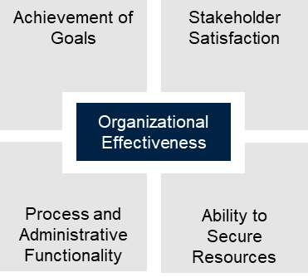
2. Agency Effectiveness
Goal attainment is too narrow
It ignores the broader context and mission
Today’s success may not be sustainable
Or not consistent in time
Systemic contributions to success:
Stakeholder support
Functional organizational processes
Continuity of resource availability

Slide 13
3. Field Level Assessment of Science
Philanthropic support of science focuses heavily on basic research
Dimensions of basic research are rarely articulated
They include at least the following:
Institutional setting
Human resource development
Content types
Uncertainty management
Expected products

Slide 14
3. Features of Each Dimension
Attributes of each dimension
Institutional setting
Academic culture; rewards on productivity and creativity; grants NOT contracts
Human resources
Early career talent (“seed corn”); community building; mentoring;
Content types
“Ontology”, natural kinds; experimental approaches; no time horizon; “leveraging”
Uncertainty management
Acknowledgement of risk; attempts to learn from failure; mapping exploration; frustrating ex-post evaluation
Expected products
Publications; reputation; career trajectory; “exemplars”; outcome disclaimers

Slide 15
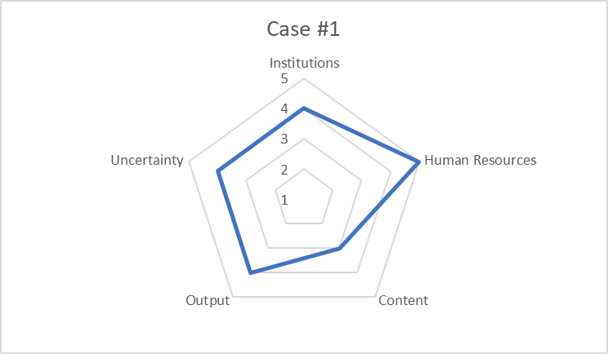
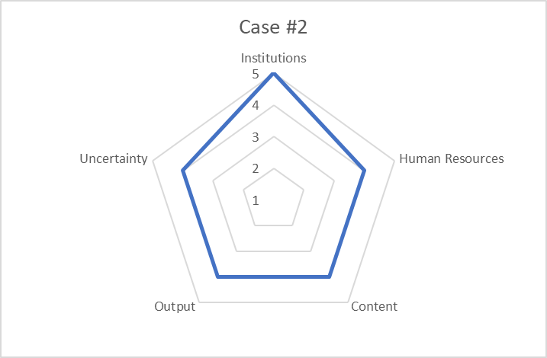
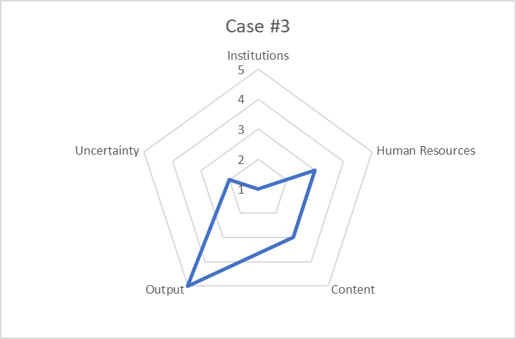
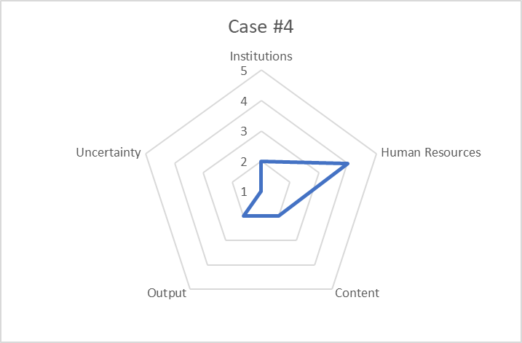
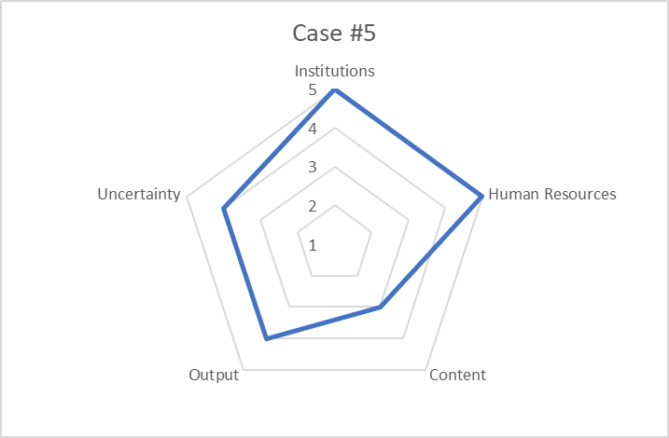
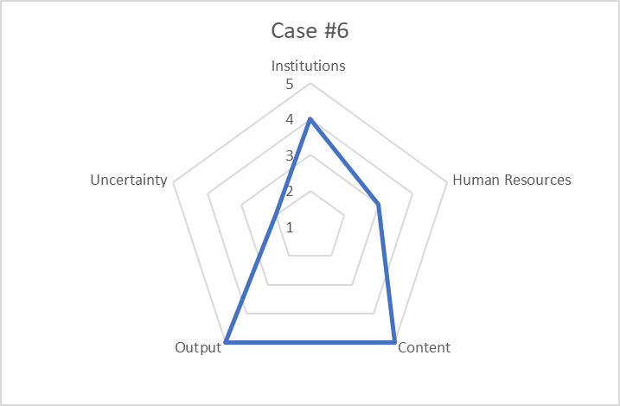
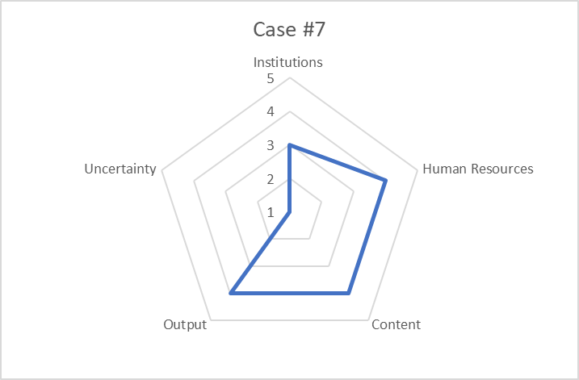
3. Patterns of Support in Foundations
Dimensions clearly present in all foundation cases
Foundations differ in combination of dimensions to emphasize

Slide 16
Principles of Systems Approaches
Systems: “The whole is more (less) than the sum of its parts”
Emergent patterns of performance due to interactions among components
Moderating effects; reinforcing and stabilizing feedback; threshold effects; saturation effects
Features of methods:
Requires mapping of some sort
Establish boundaries (full system, part of another system, relevance and importance of boundaries)
Identify components, relations/interactions, hierarchies and their attributes
Determine key observation points (data needs)
Design measures for compound effects (interactions leading to system emergent patterns)
Enabling vs. constraining; convergent vs. competing; ,
Determine time dependent phenomena (dynamics, measurement of trends)
Determine framework conditions (rules, culture, overriding values (constitutive and contextual, “ideal types”)
Features that have stable (predictable) dynamics and others that are prone to direction changes (unpredictable)
Consider the vantage point for system view
Audience for system outcomes and impacts:

Slide 17
Conclusion
Outcome and impact assessment is generally relative to a system
System thinking requires methodology flexibility and creativity
Often leads to a fundamental research project

Slide 18
Group Activity
Select the focus of interest in the group (program, agency, institution, etc.)
Determine the relevant system for your impact assessment challenges
Identify key assumptions held now: check their validity
Sketch a rough outline of the system map (“back-0f-envelope”)
Identify key interactions and the measurement challenge they represent
Identify key framework conditions that may shape the approach
Draw some conclusions to share

